Slide 1
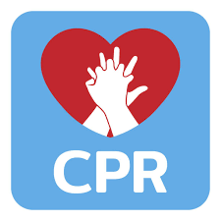
Cardio Pulmonary Resuscitation (CPR)
A.L Maher Abdul Ameer

Slide 2
What does CPR stands for?
C = Cardio (heart)
P = Pulmonary (lungs)
R = Resuscitation (recover)

Slide 3
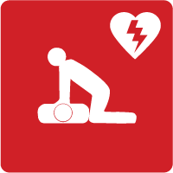
DEFINITION
Cardio pulmonary resuscitation (CPR) is a technique of basic life support for the purpose of oxygenation to the heart, lungs and brain until and unless the appropriate medical treatment can come and restore the normal cardiopulmonary function.

Slide 4
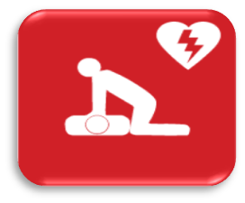
PURPOSE
Restore cardiopulmonary functioning.
Prevent irreversible brain damage from anoxia.

Slide 5
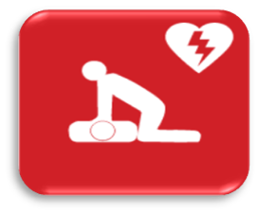
INDICATION
Cardiac arrest
Respiratory arrest
Combination of both

Slide 6
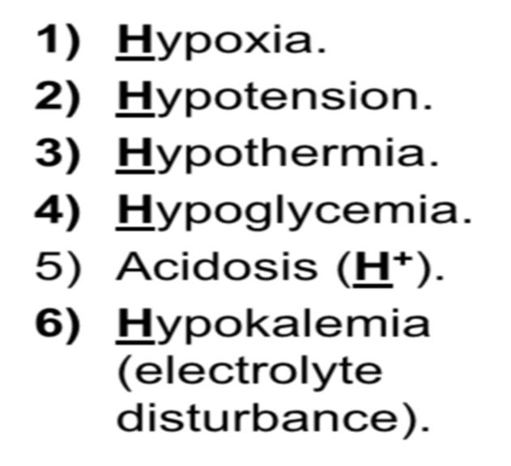
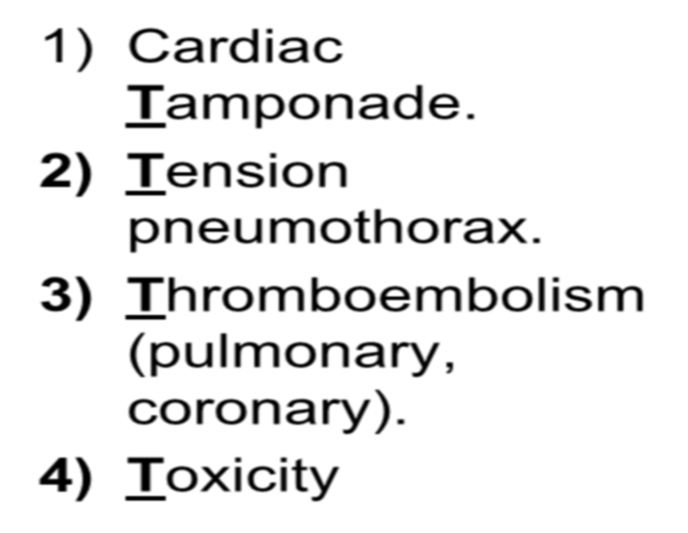
Definition of Cardiac arrest:
It is loss of cardiac function, breathing and loss of consciousness.
Causes of cardiac arrest: 6H & 4T

Slide 7
How To Do CPR

Slide 8
Steps of CPR

Slide 9
PHASES OF THE CARDIO PULMONARYRESUSCITATION
Phases |  | Steps
Phase 1 | Basic life support (BLS) | C= circulation A= Airway B= Breathing
PHASE 2 | Advance cardiac life support | D= Drugs E= ECG F= fibrillation
Phase 3 | Prolonged life support | Post resuscitation care

Slide 10
BLS & ACLS
What is basic life support (BLS)?
It is life support without the use of special equipment.
What is Advanced Life Support (ACLS)?
It is life support with the use of special equipment (eg. Airway, endotracheal tube, defibrillator).

Slide 11
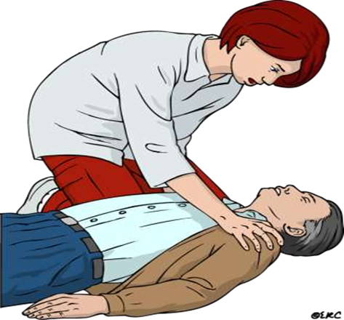
RESPONSE
Check the victim for a response.
Shake shoulders gently or shouting the victims name
Ask “Are you all right?’’

Slide 12
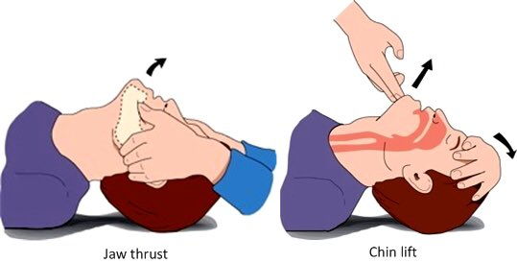
Assessment and maintain airway
Head tilt chin lift
Jaw thrust

Slide 13
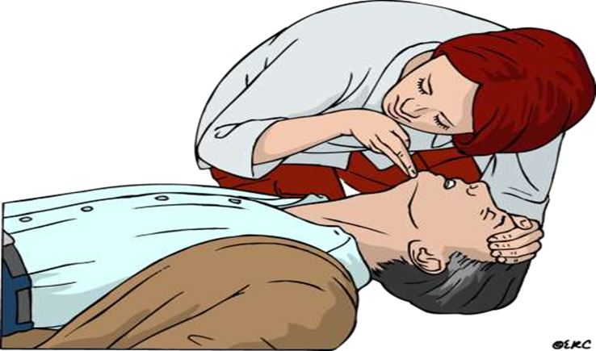
BREATHING
Look, listen and feel the breathing not more than 10 seconds
No breathing or no normal breathing
(i.e, only gasping)

Slide 14
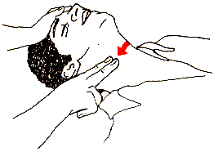
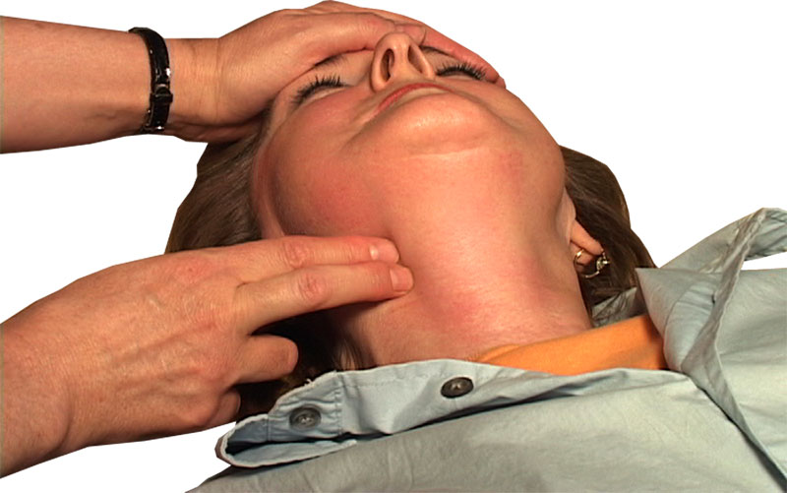
CIRCULATION
No pulse felt within 10 seconds.

Slide 15
CPR Sequence
A Change From A-B-C to C-A-B

Slide 16
Chest compressions (cardiac massage)
The human brain cannot survive more than 3 minutes with lack of circulation. So chest compressions must be started immediately for any patient with absent central pulsations

Slide 17
Technique Of Chest Compression
PT must be placed on a hard surface (wooden board).
The palm of one hand is placed in the concavity of the lower half of the sternum 2 fingers above the xiphoid process. (AVOID xiphisternal junction → fracture & injury).

Slide 18
The other hand is placed over the hand on the sternum.
Shoulders should be positioned directly over the hands with the elbows locked straight and arms extended. Use your upper body weight to compress.
Sternum must be depressed atleast 5 cm in adults, and
2-4 cm in children, 1-2 cm in infants .

Slide 19
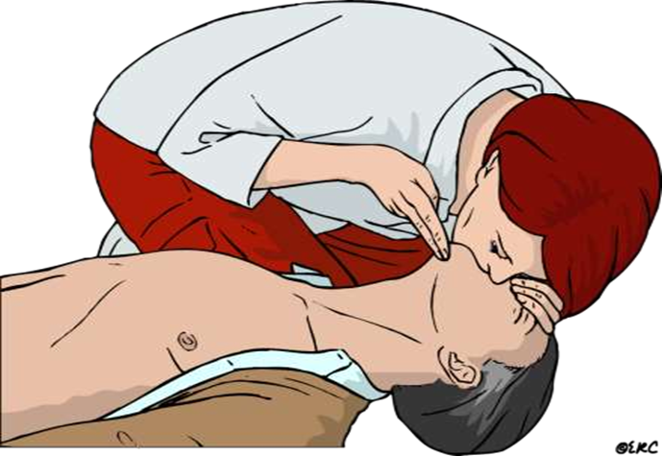
30:2
+
30
2

Slide 20
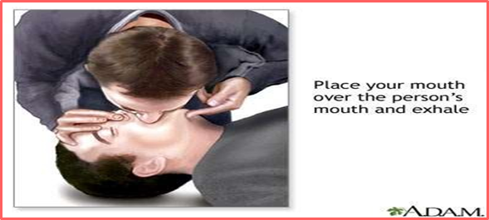
Basic breathing techniques include:
1) Mouth to mouth breathing: with the airway held open, pinch the nostrils closed, take a deep breath and seal your lips over he patients mouth. Blow steadily into the patients mouth watching the chest rise as if the patient was taking a deep breath.

Slide 21
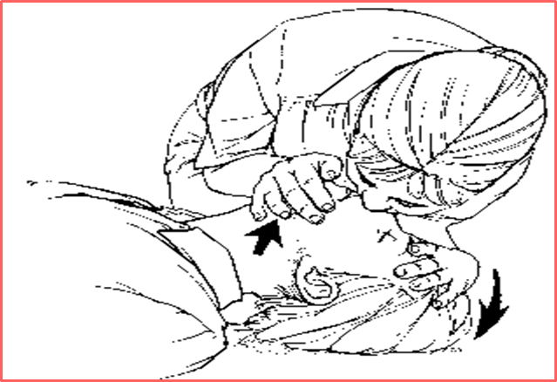
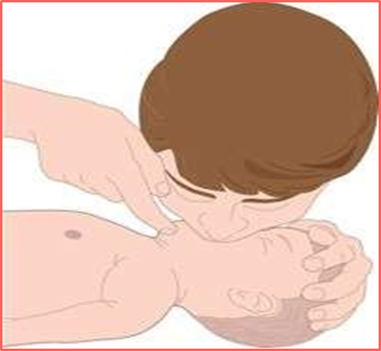
Mouth to nose breathing: seal the mouth shut and breathe steadily though the nose.
Mouth to mouth and nose: is used in infants and small children.

Slide 22
Assessment Of Restoration Of Breathing And Circulation
Contraction of pupil
Improved color of the skin
Free movement of the chest wall
Swallowing attempts
Struggling movements

Slide 23
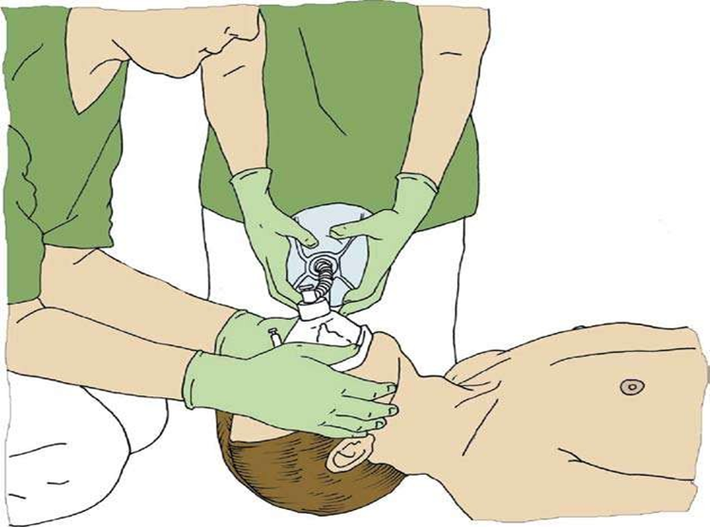
Equipment of breathing

Slide 24
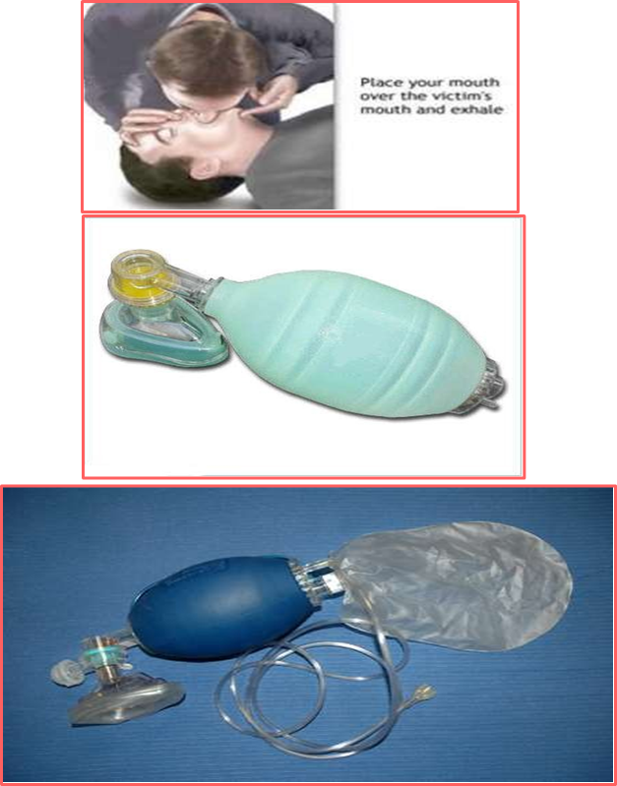
Expired air
= 16% O2
Ambu Bag (room air)
= 21% O2
Ambu bag + O2 (10-15L)
= 45% O2
Ambu Bag + O2 + Reservoir bag = 85% O2

Slide 25
When to terminate BLS
Pulse and respiration returns
Emergency medical help arrives
Physician declared patient is deceased
In a non health setting ,another indication to stop BLS would be that the rescuer was exhausted and physically unable to continue to perform BLS.

Slide 27
Thanks for listening

Slide 28
Home work
What are the differences between cardioversion and defibrillation?

